Slide 1
Rule-Based Classification

Slide 2
Learning Classification Rules Directly
A classifier is expressed in a logic-style form as a set of decision rules (if-then rules)
  decision rules are one of the most expressible and comprehensible knowledge representations
Two classes of methods:
  Learning attributional rules (AQ family, CN2, etc.)
  Learning relational descriptions (INDUCE, FOIL, PROGOL, etc. )

Slide 3
Concept Learning
Concept [from Latin concipere = to seize (a thought)]
Two opposing views:
  EXTENSIONAL: a specified set of physical or abstract objects
  INTENSIONAL: a set of (necessary and) sufficient conditions (Wittgenstein, 1953).
Induce a set of sufficient conditions from a sample of positive and negative examples of the concept

Slide 4
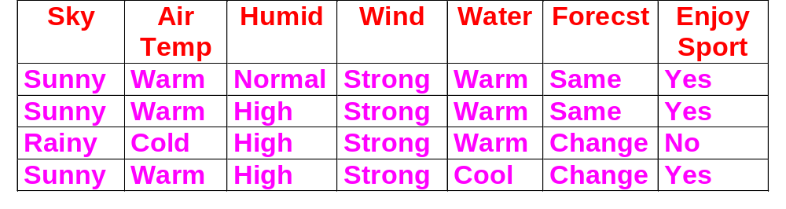
A Concept Learning Task
Positive and negative training examples (instances) for the target concept EnjoySport
Task: learning to predict the value of EnjoySport for an arbitrary day

Slide 5
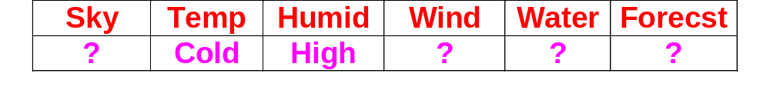
Representing Hypotheses
A hypothesis h is a conjunction of constraints on the instance attributes (conjunctive concept)
Each constraint can be:
  a specific value (e.g., “Water=Warm”)
  don’t care (e.g., “Water=?”)
  no value allowed (e.g., “Water=Ø”)
h = ⟨sunny, warm, ?, strong, ?, ?⟩
can be rewritten as:
IF Sky=sunny ∧ AirTemp=Warm ∧ Wind=strong
THEN EnjoySport=Yes

Slide 6
A Formalization
Given
  Instances X:
  Possible days, each described by the attributes Sky, Temp, Humidity, Wind, Water, Forecast
  Training examples D: ⟨ x_{i}, c(x_{i}) ⟩
  Target concept c:
  EnjoySport : X → {0,1}
  c(x)=1 if EnjoySport=yes
  c(x)=0 if EnjoySport=no
  Hypotheses H:
  Expressed as conjunction of constraints on the attributes

Slide 7
A Formalization
Determine
  A hypothesis h in H such that
  h(x) = c(x) for all x in X
The learning task is to determine a hypothesis h identical to the target concept c over the entire set of instances X.

Slide 8
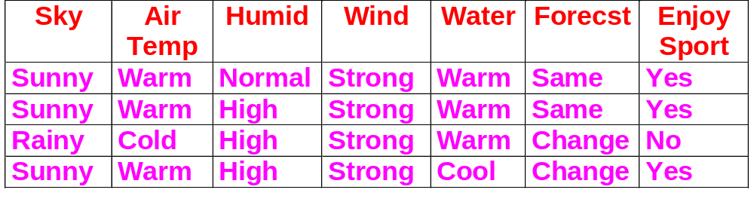
What information is available?
D
Typically, D ⊂ X.
If Sky has three possible values, and
AirTemp, Humidity,Wind, Water, Forecast each have two possible values
Then X has 3·2 ·2 ·2 ·2 · 2 = 96 distinct instances.
|D|=4

Slide 9
The inductive learning hypothesis
Any hypothesis found to approximate the target function well over a sufficiently large set of training examples will also approximate the target function well over other unobserved examples.

Slide 10
Concept Learning as Search
Concept learning can be viewed as the task of searching through a large space of hypotheses H.
The goal of the search is to find the hypothesis that best fits the training examples.
The space of hypotheses is implicitly defined by the hypotheses representation.

Slide 11
An example
A hypothesis h is a conjunction of constraints on the instance attributes. Each constraint can be:
  a specific value
  don’t care, ?
  no value allowed, Ø
H has 5·4 ·4 ·4 ·4 · 4 = 5120 syntactically distinct hypotheses.

Slide 12
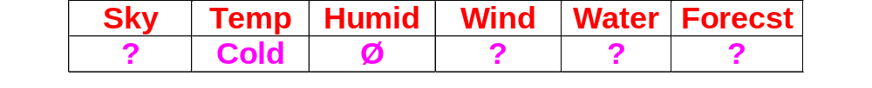
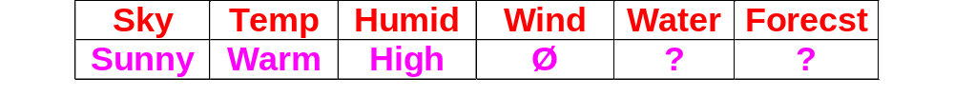
Semantically distinct hypotheses
h
h’
Both hypotheses represent the empty set of instances ⇒ every instance is classified as negative.
Semantically distinct hypotheses:
1+(4·3 ·3 ·3 ·3 · 3) = 973
Typically the search space is much larger, sometimes infinite.

Slide 13
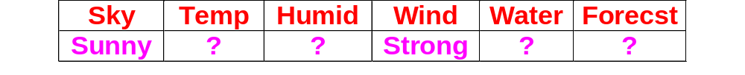
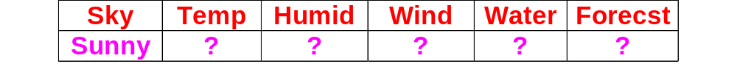
Efficient search: how ?
Naive search strategy: generate-and-test all hypotheses in H.
Impossible for infinite (or very large) search space.
The search can rely on the structure defined by a general-to-specific (or subsumption) ordering of hypotheses.
h₁
h₂
h₂ is more general than (subsumes) h₁.

Slide 14

General-to-specific (subsumption) ordering
Given two hypotheses h_{k} and h_{j}
h_{j} is more general or equal to h_{k}
h_{j} ≥_{g} h_{k}
  if and only if any instance that satisfies h_{k} also satisfies h_{j}.
  h_{j} is strictly more general than h_{k}
h_{j} >_{g} h_{k}
  if and only if h_{j} ≥_{g} h_{k} and h_{k} h_{j} .
The inverse relation more_specific_than can be defined as well.

Slide 15


Instances X
Hypotheses H
General
x₁
h₂
x₂
h₁
h₃
Specific
x₁ = ⟨Sunny, Warm, High, Strong, Cool, Same⟩
x₂ = ⟨Sunny, Warm, High, Light, Warm, Same ⟩
h₁ = ⟨Sunny, ?, ?, Strong, ?, ?⟩
h₂ = ⟨Sunny, ?, ?, ?, ?, ?⟩
h₃ = ⟨Sunny, ?, ?, ?, Cool, ?⟩

Slide 16
Terminology
A hypothesis h covers a positive example if it correctly classifies the example as positive
h(x)=c(x)=1
An example ⟨x ,c(x)⟩ satisfies hypothesis h when h(x)=1 regardless of whether x is a positive or negative example of the target concept.
A hypothesis h is consistent with an example ⟨x ,c(x)⟩ when h(x)=c(x).
A hypothesis h is consistent with a training set D if it is consistent with each example x∈D

Slide 17
Taking advantage of the general-to-specific ordering
One way is to begin with the most specific possible hypothesis in H, then generalize this hypothesis each time it fails to cover an observed positive training example (bottom-up search)
Find a maximally specific hypothesis

Slide 18
Example
h ← ⟨Ø, Ø , Ø , Ø , Ø , Ø⟩
Consider the first example in D: ⟨Sunny, Warm, Normal, Strong, Warm, Same⟩, +
The maximally specific hypothesis is h← ⟨Sunny, Warm, Normal, Strong, Warm, Same⟩
Consider the second example in D: ⟨Sunny, Warm, High, Strong, Warm, Same⟩, +
The maximally specific hypothesis is h← ⟨Sunny, Warm, ?, Strong, Warm, Same⟩
The third example is ignored since negative: ⟨Rainy, Cold, High, Strong, Warm, Change⟩, -
Consider the fourth example in D: ⟨Sunny, Warm, High, Strong, Cool, Change⟩, +
The maximally specific hypothesis is h← ⟨Sunny, Warm, ?, Strong, ?, ?⟩

Slide 19


Instances X
Hypotheses H
h₄
General
x₃
⊕
⊕
h_{2,3}
x₁
x₂
⊕
x₄
h₁
Specific
h₀
h₀ = ⟨Ø, Ø, Ø, Ø, Ø, Ø ⟩
x₁ = ⟨Sunny, Warm, Normal, Strong, Warm, Same⟩
h₁ = ⟨Sunny, Warm, Normal, Strong, Warm, Same⟩
x₂ = ⟨Sunny, Warm, High, Strong, Warm, Same⟩
h₂ = ⟨Sunny, Warm, ?, Strong, Warm, Same⟩
x₃ = ⟨Rainy, Cold, High, Strong, Warm, Change⟩
h₃ = ⟨Sunny, Warm, ?, Strong, Warm, Same⟩
x₄ = ⟨Sunny, Warm, High, Strong, Cool, Change⟩
h₄ = ⟨Sunny, Warm, ?, Strong, ?, ?⟩

Slide 20
FIND-S Algorithm
1. Initialize h to the most specific hypothesis in H
2. For each positive training instance x
2.1 For each attribute constraint a_{i} in h
if the constraint a_{i} is satisfied by x
Then do nothing
Else replace a_{i} in h by the next more
general constraint that is satisfied by x
3. Output hypothesis h

Slide 21
No revision in case of negative example: Why?
Basic assumptions:
  the target concept c is in H
  no errors in training data
h is the most specific hypothesis in H
therefore c ≥_{g} h
but c will never be satisfied by a negative example
thus neither will h.

Slide 22
Limitations of Find-S
Can’t tell whether the learner converged to the correct target concept
  Has it found the only hypothesis in H consistent with the data, or there are many other consistent hypotheses as well?
Picks a maximally specific hypothesis.
  Why should we prefer this hypothesis over, say, the most general?

Slide 23
Limitations of Find-S (cont.)
Can’t tell when training data are inconsistent
  Inconsistency in training examples can mislead Find-S, since it ignores negative examples. Is it possible to detect such inconsistency?
There might be several maximally specific consistent hypotheses.
  Find-S should backtrack on its choices in order to explore a different branch of the partial ordering than the branch it has selected.

Slide 24

Version Space
Return a version space instead of a single hypothesis.
The version space, VS_{H,D}, with respect to hypothesis space H and training examples D, is the subset of hypotheses from H consistent with the training examples in D.
VS_{H,D}≡{h∈H | Consistent(h,D)}

Slide 25
The List-Then-Eliminate algorithm
1. VS_{H,D} ← a list containing every hypothesis in H
2. For each training example, ⟨x,c(x)⟩
remove from VS_{H,D} any hypothesis h for which h(x)≠c(x)
3. Output the list of hypotheses in VS_{H,D}

Slide 26
Pros and cons
Guaranteed to output all hypotheses consistent with the training data
Can detect inconsistencies in the training data
Exhaustive enumeration of all hypotheses:
  possible only for finite spaces H
  unrealistic for large spaces H

Slide 27

Version Space: A compact representation
The version space can be represented by its most general and least general members
(version space representation theorem)
Most general hypothesis
General
H
G
VS_{H,D}
S
Specific
Training instances

Slide 28
General boundary
The general boundary G, with respect to hypothesis space H and training data D, is the set of maximally general members of H consistent with D
G ≡ { g∈H | Consistent(g,D) ∧
(¬ ∃g’ ∈H [(g’ >_{g} g) ∧ Consistent(g’,D)] }

Slide 29
Specific boundary
The specific boundary S, with respect to hypothesis space H and training data D, is the set of minimally general (i.e., maximally specific) members of H consistent with D
S ≡ { s∈H | Consistent(s,D) ∧
(¬ ∃s’ ∈H [(s >_{g} s’) ∧ Consistent(s’,D)] }

Slide 30
A Version Space
G
{ ⟨Sunny, ?, ?, ?, ?, ?⟩, ⟨?, Warm, ?, ?, ?, ?⟩ }
⟨Sunny,?,?,Strong,?,?⟩ ⟨Sunny,Warm,?,?,?,?⟩ ⟨?,Warm,?,Strong,?,?⟩
S
{⟨Sunny, Warm, ?, Strong, ?, ?⟩ }

Slide 31





Candidate-Elimination algorithm
G ← maximally general hypotheses in H
S ← maximally specific hypotheses in H
For each training example d, do
  if d is a positive example
    Remove from G any hypothesis inconsistent with d
    UPDATE-S routine: For each hypothesis s in S that is not consistent with d
      Remove s from S
      Add to S all minimal generalizations h of s such that
        h is consistent with d, and
        some member of G is more general than h
      Remove from S any hypothesis that is more general than another hypothesis in S
H
H
H
H
H
G
G
G
G
G
⊕
⊕
⊕
⊕
⊕
⊕
⊕
⊕
VS_{H,D}
VS_{H,D}
VS_{H,D}
VS_{H,D}
VS_{H,D}
⊕
⊕
⊕
⊕
⊕
⊕
S
S
S
S
S

Slide 32

Candidate-Elimination algorithm (cont.)
  if d is a negative example
    Remove from S any hypothesis inconsistent with d
    UPDATE-G routine: For each hypothesis g in G that is not consistent with d
      Remove g from G
      Add to G all minimal specializations h of g such that
        h is consistent with d, and
        some member of S is more specific than h
      Remove from G any hypothesis that is less general than another hypothesis in G
H
H
H
H
H
G
G
G
G
G


VS_{H,D}
VS_{H,D}
VS_{H,D}
VS_{H,D}
VS_{H,D}
S
S
S
S
S





Slide 33
D
G
{ ⟨Sunny, ?, ?, ?, ?, ?⟩, ⟨?, Warm, ?, ?, ?, ?⟩ }
⟨Sunny,?,?,Strong,?,?⟩ ⟨Sunny,Warm,?,?,?,?⟩ ⟨?,Warm,?,Strong,?,?⟩
S
{⟨Sunny, Warm, ?, Strong, ?, ?⟩ }

Slide 34
What does the Candidate-Elimination algorithm converge to?
The algorithm will converge towards the target concept
provided that
there are no errors in the training examples
there is some hypothesis in H that correctly describes the target concept
The target concept is learned when the S and G boundary sets converge to a single, identical, hypothesis.

Slide 35
Empty Version Space
The algorithm outputs an empty version space when:
  training data contain errors (a positive example is presented as negative).
  the target concept cannot be described in the hypothesis representation.

Slide 36
Other characteristics
The Candidate-Elimination algorithm performs a bi-directional search.
G and S can grow exponentially in the number of training examples.

Slide 37
How can partially learned concepts be used?
G
{ ⟨Sunny, ?, ?, ?, ?, ?⟩, ⟨?, Warm, ?, ?, ?, ?⟩ }
⟨Sunny,?,?,Strong,?,?⟩ ⟨Sunny,Warm,?,?,?,?⟩ ⟨?,Warm,?,Strong,?,?⟩
S
{⟨Sunny, Warm, ?, Strong, ?, ?⟩ }
⟨Sunny, Warm, Normal, Strong, Cool, Change⟩
POSITIVE: unanimous agreement

Slide 38
How can partially learned concepts be used?
G
{ ⟨Sunny, ?, ?, ?, ?, ?⟩, ⟨?, Warm, ?, ?, ?, ?⟩ }
⟨Sunny,?,?,Strong,?,?⟩ ⟨Sunny,Warm,?,?,?,?⟩ ⟨?,Warm,?,Strong,?,?⟩
S
{⟨Sunny, Warm, ?, Strong, ?, ?⟩ }
⟨Rainy, Cold, Normal, Light, Warm, Same⟩
NEGATIVE: unanimous agreement

Slide 39
How can partially learned concepts be used?
G
{ ⟨Sunny, ?, ?, ?, ?, ?⟩, ⟨?, Warm, ?, ?, ?, ?⟩ }
⟨Sunny,?,?,Strong,?,?⟩ ⟨Sunny,Warm,?,?,?,?⟩ ⟨?,Warm,?,Strong,?,?⟩
S
{⟨Sunny, Warm, ?, Strong, ?, ?⟩ }
⟨Sunny, Cold, Normal, Strong, Warm, Same⟩
Two positive, four negative

Slide 40
How can partially learned concepts be used?
In this case we have less confidence in the classification than in the unambiguous cases.
Still the vote is in favor of a negative classification
Possible approach: output the majority vote
Assuming that all hypotheses in H are equally probable a priori, then
  the majority vote provides the most probable classification of this new instance
  the proportion of hypotheses voting positive can be interpreted as the probability that this instance is positive given the training data

Slide 41

An interactive learning algorithm
The learning algorithm is allowed to choose the next instance (query) and receive the correct classification from an external oracle (e.g., nature or a teacher).
If the algorithm always chooses a query that is satisfied by only half of hypotheses in VS, then the correct target concept can be found in
steps

Slide 42
How can partially learned concepts be used?
G
{ ⟨Sunny, ?, ?, ?, ?, ?⟩, ⟨?, Warm, ?, ?, ?, ?⟩ }
⟨Sunny,?,?,Strong,?,?⟩ ⟨Sunny,Warm,?,?,?,?⟩ ⟨?,Warm,?,Strong,?,?⟩
S
{⟨Sunny, Warm, ?, Strong, ?, ?⟩ }
⟨Sunny, Warm, Normal, Light, Warm, Same⟩
Half positive, half negative

Slide 43
An interactive learning algorithm
This instance is an optimal query to be presented to the trainer in interactive learning
In general, those instances whose classification is most ambiguous are precisely the instances whose true classification would provide the most new information for refining the version space
Generally, it’s impossible to adopt this optimal search strategy.

Slide 44
Dealing with noisy training instances
Relax the condition that the concept descriptions be consistent with all of the training instances.
Solution for a bounded, predetermined number of misclassified examples:
maintain several G and S sets of varying consistency.
H
G₂
G₁
G₀
S₀
S₁
S₂

Slide 45
Dealing with noisy training instances (cont.)
The set S_{i} is consistent with all but i of the positive training examples
The set G_{i} is consistent with all but i of the negative training examples
When G₀ crosses S₀ the algorithm can conclude that no concept in the rule space is consistent with all of the training instances.
The algorithm can recover and try to find a concept that is consistent with all but one of the training examples.

Slide 46
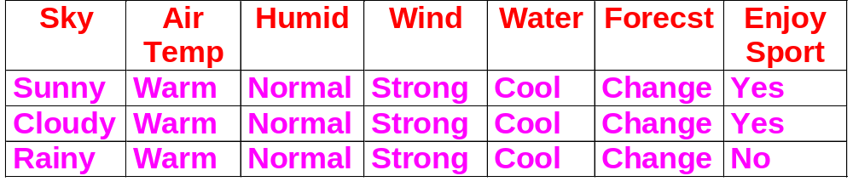
What if the concept is not contained in the hypothesis space?
Cannot represent disjunctive target concepts, such as “Sky=Sunny or Sky=Cloudy”
A more expressive hypothesis space is requested.

Slide 47
A hypothesis space that includes every possible hypothesis?
Choose H that expresses every teachable concept (i.e., H is the power set of X).
Consider H’= disjunctions, conjunctions, negations over previous H.
⟨Sunny,Cold,Normal,?,?,?⟩ ∨¬ ⟨?,?,?,?,?,Change⟩
What are S and G in this case?
S is the disjunction of positive examples presented so far
G is the negation of the disjunction of negative examples seen so far
Totally useless. No generalization at all !

Slide 48
A fundamental property of inductive inference
“A learning algorithm that makes no a priori assumptions regarding the identity of the target concept has no rational basis for classifying any unseen instance.”
Prior assumption ≡ inductive bias
Do not confuse with the estimation bias commonly used in statistics.

Slide 49
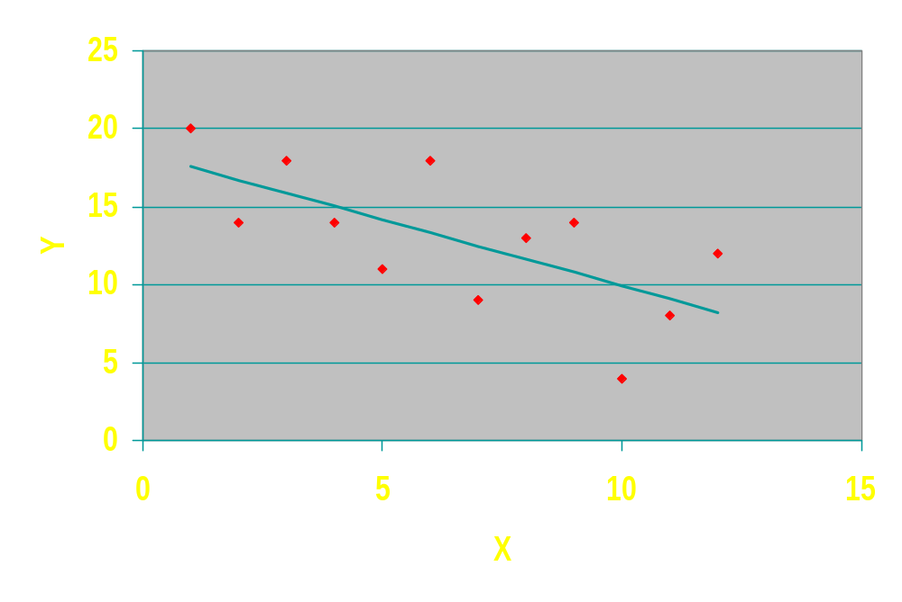
Linear Regression
The underlying prior assumption (i.e., inductive bias) is that the relationship between X and Y is linear.

Slide 50
A formal definition of inductive bias
Consider
concept learning algorithm L
instances X
target concept c
training examples D_{c}={ ⟨x,c(x)⟩ }
let L(x_{i},D_{c}) denote the classification assigned to the instance x_{i} by L after training on data D_{c}.
The inductive bias of L is any minimal set of assertions B such that for any target concept c and corresponding training examples D_{c}
(∀x_{i}∈X) [(B ∧ D_{c} ∧ x_{i} ) ⇒ L(x_{i},D_{c}) ]

Slide 51
Modeling inductive systems by equivalent deductive systems
Inductive System
Training examples
Classification of new instance, or “don’t know”
Learning Algorithm
New instance
Deductive System
Training examples
Classification of new instance, or “don’t know”
Theorem
Prover
New instance
Inductive Bias
The inductive bias that is explicitly input to the theorem prover is only implicit in the code of the learning algorithm.

Slide 52
Inductive Bias of the Candidate-Elimination algorithm
The target concept c is contained in the given hypothesis space H.
From c∈H deductively follows c∈VS_{H,D}.
L outputs the classification L(x_{i},D_{c}) if and only if every hypothesis in VS_{H,D} also produces this classification, including the hypothesis c∈VS_{H,D} (inductive bias). Therefore c(x_{i})=L(x_{i},D_{c}).

Slide 53
Comparing the inductive bias of learning algorithms
The inductive bias is a nonprocedural means of characterizing learning algorithms policy for generalizing beyond the observed data.
Rote learning: Store examples, Classify x iff it matches previously observed example
No inductive bias for the rote learning.
Notes:
Rote learning = apprendimento meccanico

Slide 54
Comparing the inductive bias of learning algorithms
Inductive bias of the candidate elimination algorithm: the target concept can be represented in its hypothesis space.
Inductive bias of Find-S: the target concept can be represented in its hypothesis space + all instances are negative instances unless the opposite is entailed by its other knowledge (a kind of default or nonmonotonic reasoning)

Slide 55
Learning disjunctive concepts: How?
Candidate-Elimination is a least-commitment algorithm: it generalizes only when it is forced to.
Disjunction provides a way of avoiding any generalization at all: the algorithm is never forced to generalize.
In order to learn disjunctive concepts, some method must be found for controlling the introduction of disjunctions, so to prevent trivial disjunctions.
Sequential covering is a widespread approach to learning sets of rules.

Slide 56
Sequential Covering algorithms
Perform repeated candidate-elimination runs to find several conjunctive descriptions that together cover all of the training instances.
At each run, a conjunctive concept is found that is consistent with some of the positive training examples and all of the negative training examples.
The positive instances that have been accounted for are removed from further consideration, and the process is repeated until all positive examples have been covered.
+
+
-
-
+
+
-
+
+
-
+

Slide 57
Sequential Covering Algorithm
Sequential-Covering(Target_attribute,Attributes, Examples, Threshold)
Learned_rules ← Ø
Rule ← LEARN-ONE-RULE(Target_attribute,Attributes,
Examples)
while PERFORMANCE(Rule,Examples) > Threshold do
  Learned_rules ← Learned_rules ∪ { Rule }
  Examples ← Examples - { examples correctly
  covered by Rule }
  Rule ← LEARN-ONE-RULE(Target_attribute,Attributes
Examples)
Learned_rules ← sort Learned_rules according to PERFORMANCE over Examples
return Learned_rules

Slide 58
LEARN-ONE-RULE
LEARN-ONE-RULE accepts a set of positive and negative training examples as input, then outputs a single rule that covers many of the positive examples and no negative examples.
High accuracy, but not necessarily high coverage.
How to implement this procedure?
By applying the Candidate-Elimination algorithm

Slide 59
Sequential Covering + Candidate Elimination
1. Initialize S to contain one positive training example (seed example).
2. For each negative training instance apply the Update-G routine to G.
3. Choose a description g from G as one conjunction for the solution set.
Since Update-G has been applied using all the negative examples, g covers no negative examples.However, g may cover several of the positive examples.
4. Remove from further consideration all positive examples covered by g.
5. Repeat steps 1 through 4 until all positive examples are covered.

Slide 60
Sequential Covering + Candidate Elimination
g₁
S₁
+
+
-
-
+
+
-
-
-
-
+
+
-
+
g₂
S₂
+
-
-

Slide 61
General-to-specific search
A different approach to implementing LEARN-ONE-RULE is to organize the hypothesis space search according to general-to-specific ordering, and to explore the space in a greedy fashion.
Top-down or general-to-specific greedy search.

Slide 62
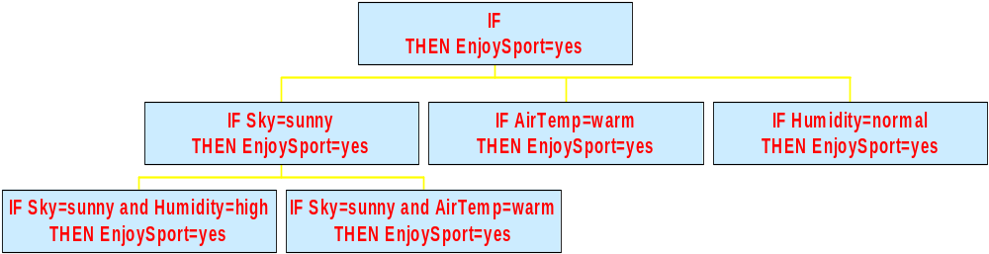
The search space for rule preconditions
The search starts by considering the most general rule precondition possible (the empty test that matches every example).
At each step, the test that most improves rule performance is added.

Slide 63
General-to-specific search
The addition of a new test restricts the coverage of the rule
The “best” test is that including as many positive examples as possible and excludes as many negative examples as possible.
Suppose a rule covers a total of t instances, of which p are positive examples and t-p are negative examples. Then choose the rule that maximizes the purity ratio p/t.

Slide 64
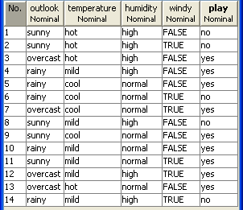
General-to-specific search
Initially, we consider the rule:
IF { } THEN play = yes
This rule has a poor performance, since it covers all the examples in the training set.

Slide 65
General-to-specific search
The following tests are possible:
Outlook = sunny 2/5
Outlook = overcast 4/4
Outlook = rainy 3/5
Temperature = hot 2/4
Temperature = mild 4/6
Temperature = cool 3/4
Humidity = high 3/7
Humidity = normal 6/7
Windy = true 3/6
Windy = false 6/8
We select the largest fraction 4/4 and create the consistent rule
IF Outlook=overcast THEN play = yes

Slide 66
General-to-specific search
We delete examples covered by this rule.
Again, we consider the rule:
IF { } THEN play = yes
and we consider alternative tests:
Outlook = sunny 2/5
Outlook = rainy 3/5
Temperature = hot 0/2
Temperature = mild 3/5
Temperature = cool 2/3
Humidity = high 1/5
Humidity = normal 4/5
Windy = true 1/4
Windy = false 4/6
We select the largest fraction 4/5 and create the rule
IF Humidity=normal THEN play = yes

Slide 67
General-to-specific search
The rule is still not consistent. Therefore it is further specialized. To this aim we consider ONLY examples covered by this rule.
We consider alternative tests:
Outlook = sunny 2/2
Outlook = rainy 2/3
Temperature = hot 0/0 ➔ 0
Temperature = mild 2/2
Temperature = cool 2/3
Windy = true 1/2
Windy = false 3/3
We have a tie: 2/2 vs. 3/3. We choose the test with the greatest coverage and create a consistent rule
IF Humidity=normal AND Windy=false
THEN play = yes

Slide 68
General-to-specific search
We delete examples covered by this rule.
Again, we consider the rule:
IF { } THEN play = yes
and we consider alternative tests:
Outlook = sunny 1/4
Outlook = rainy 1/3
Temperature = hot 0/2
Temperature = mild 2/4
Temperature = cool 0/1
Humidity = high 1/5
Humidity = normal 1/2
Windy = true 1/4
Windy = false 1/3
We select the largest fraction 1/2 and create the rule
IF Humidity=normal THEN play = yes

Slide 69
General-to-specific search
The rule is still not consistent. Therefore it is further specialized. To this aim we consider ONLY examples covered by this rule.
We consider alternative tests:
Outlook = sunny 1/1
Outlook = rainy 0/1
Temperature = mild 1/1
Temperature = cool 0/1
Windy = true 1/2
Windy = false 0/0
We select the largest fraction 1/1 and create the consistent rule
IF Humidity=normal AND Temperature=mild
THEN play = yes

Slide 70
General-to-specific search
We delete examples covered by this rule.
Again, we consider the rule:
IF { } THEN play = yes
and we consider alternative tests:
Outlook = sunny 0/3
Outlook = rainy 1/3
Temperature = hot 0/2
Temperature = mild 1/3
Temperature = cool 0/1
Humidity = high 1/5
Humidity = normal 0/1
Windy = true 0/3
Windy = false 1/3
We select the largest fraction 1/3 and create the rule
IF Outlook=rainy THEN play = yes

Slide 71
General-to-specific search
The rule is still not consistent. Therefore it is further specialized. To this aim we consider ONLY examples covered by this rule.
We consider alternative tests:
Temperature = mild 1/2
Temperature = cool 0/1
Humidity = high 1/2
Humidity = normal 0/1
Windy = true 0/2
Windy = false 1/1
We select the largest fraction 1/1 and create the consistent rule
IF Outlook=rainy AND Windy=false THEN play = yes

Slide 72
General-to-specific search
The final set of rules for the concept play = yes is:
IF Outlook = overcast THEN yes
IF Humidity = normal
AND Windy = false THEN yes
IF Humidity = normal
AND Temperature = mild THEN yes
IF Outlook = rainy
AND windy = false THEN yes

Slide 73
General-to-specific search
What we have just described is the PRISM method for constructing rules
(Cendrowska, 1987)
It generates only correct or “perfect” rules.
It measures the success of a rule by the purity formula p/t.
Any rule with purity less than 100% is “incorrect”

Slide 74
General-to-specific search
Initialize E to the set of positive examples
While E ≠ ∅
Create a rule R with an empty left hand-side (LHS)
Until R is perfect (or there are no more attributes to use) do
For each attribute A not mentioned in R, and each value v,
Consider adding the condition A=v to LHS of R
Select A and v to maximize the accuracy p/t
(break ties by choosing the condition with the largest p)
Add A=v to R
Remove the positive examples covered by R from E

Slide 75
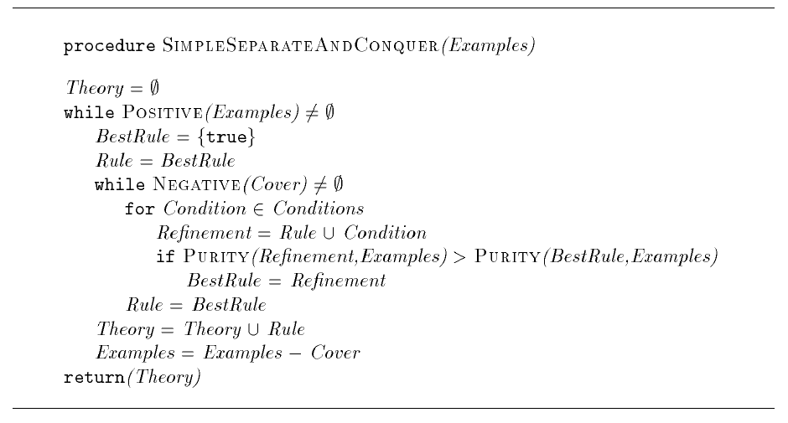
A simple separate-and-conquer (or sequential covering) algorithm
Theory=set of rules

Slide 76
A simple separate-and-conquer (or sequential covering) algorithm
All separate­and­conquer algorithms share the basic structure of this simple algorithm. However, many learning tasks require modifications of this procedure.
The induction of a set o rule that is complete and consistent, for example, can lead to overfitting if the data are noisy. Thus many algorithms relax this constraint and use stopping criteria or post­processing methods to be able to learn simpler theories that are not complete and consistent, but are more predictive on unseen data.

Slide 77
A simple separate-and-conquer (or sequential covering) algorithm
Other algorithms replace the top­down search of the inner while­loop with a bottom­up search, where rules are successively generalized starting with a most specific rule (e.g. consisting of one of the positive examples itself). ➔ see Sequential-covering + candidate elimination
Yet other algorithms do not use hill­climbing, but employ less myopic search algorithms like beam search or best­first search.

Slide 78
Beam search
The general-to-specific search is generally a greedy depth-first search with no backtracking.
Danger of a suboptimal choice at any step
To reduce this risk a beam search is sometimes performed.
A list of the k best candidates at each step is kept, rather than a single best candidate.
Both CN2 (Clark & Niblett, 1989) and AQ (Michalski, 1969, 1986) perform a top-down beam search. AQ is also based on seed examples to guide the search for rules.

Slide 79
A simple separate-and-conquer (or sequential covering) algorithm
Another issue is the type of conditions that can be used in the formulation of the hypotheses. This basic algorithm can only formulate rules in propositional logic, but research in inductive logic programming has developed algorithms that can learn rules in first­order logic.

Slide 80
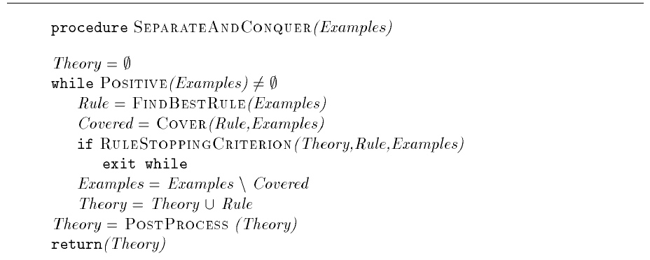
A generic separate-and-conquer (or sequential covering) algorithm
A generic separate­and­conquer rule learning algorithm that calls various subroutines which can be used to instantiate the generic algorithm into specific algorithms known from the literature.

Slide 81
General-to-specific search
SeparateAndConquer starts with an empty theory. If there are any positive examples in the training set it calls the subroutine FindBestRule for learning a rule that will cover a subset of the positive examples.
All covered examples are then separated from the training set, the learned rule is added to the theory, and another rule is learned from the remaining examples.
Rules are learned in this way until no positive examples are left or until the RuleStoppingCriterion fires.
Often the resulting theory undergoes some PostProcessing.

Slide 82
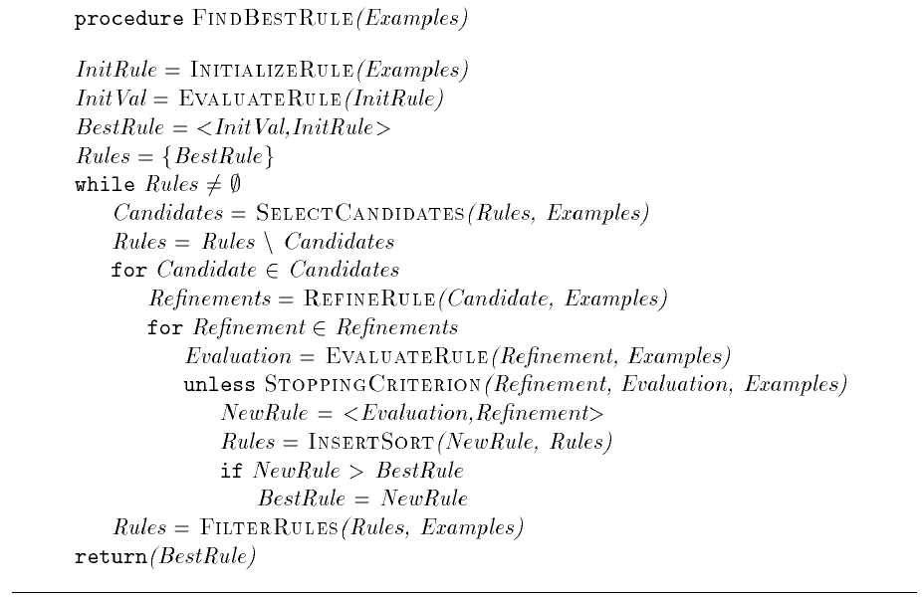
A generic separate-and-conquer (or sequential covering) algorithm

Slide 83
General-to-specific search
The procedure FindBestRule searches the hypothesis space for a rule that optimizes a given quality criterion defined in EvaluateRule.
The value of this heuristic function usually is the higher the more positive and the less negative examples are covered by the candidate rule.
FindBestRule maintains Rules, a sorted list of candidate rules, which is initialized by the procedure InitializeRule. New rules will be inserted in appropriate places (InsertSort), so that Rules will always be sorted in decreasing order by the heuristic evaluations of the rules.

Slide 84
General-to-specific search
At each cycle SelectCandidates selects a subset of these candidate rules, which are then refined using RefineRule.
Here we use the term ``refinement'' for both specialization and generalization.
Each refinement is evaluated and inserted into the sorted Rules list unless the StoppingCriterion prevents this.
If the evaluation of the NewRule is better than the best rule found previously, the BestRule is set to NewRule.
FilterRules selects the subset of the ordered rule list that will be used in further iterations. When all candidate rules have been processed, the best rule will be returned.

Slide 85
General-to-specific search
As an example, assume we want to instantiate the generic algorithm into the simple separate-and-conquer algorithm.
SimpleSeparateAndConquer searches the hypothesis space in a top­down fashion. InitializeRule will thus return the most general rule, i.e. the rule with the body {true}.
RefineRule will specialize a given rule by adding a condition to it. The rules will be evaluated by the percentage of covered examples that are positive, i.e. EvaluateRule will implement the Purity subroutine used in the simple separate-and-conquer algorithm.

Slide 86
General-to-specific search
FilterRules will only let the best refinement pass for the next iteration, so that SelectCandidates will always have only one choice. Together these two procedures implement the hill­climbing search.
As of the sorted list of all refinements only the first (and best) element will be used, this part of the code is equivalent to the corresponding part in SimpleSeparateAndConquer.
Both stopping criteria will always be false and the learned rules will not be post­processed.

Slide 87
General-to-specific search
PRISM also returns rules for the Play=no
IF Outlook = sunny AND Humidity = high THEN no
IF Outlook = rainy AND Windy = true THEN no
In other terms, PRISM implements the following algorithm:

Slide 88
General-to-specific search
For each class C
Initialize E to the instance set
While E contains instances in class C
Create a rule R with an empty left hand-side (LHS)
that predicts class C
Until R is perfect (or there are no more attributes to use) do
For each attribute A not mentioned in R, and each value v,
Consider adding the condition A=v to LHS of R
Select A and v to maximize the accuracy p/t
(break ties by choosing the condition with the largest p)
Add A=v to R
Remove the positive examples covered by R from E

Slide 89
Simultaneous vs. sequential covering algorithm
Sets of rules can be obtained by converting decision trees (Quinlan, 1987).
C4.5 can be considered a simultaneous covering algorithm, in contrast to sequential covering algorithms.
Sequential covering algorithm are slower.
To learn a set of n rules, each containing k attribute-value tests in their preconditions, sequential covering algorithm will perform n·k primitive search steps (independent choices).

Slide 90
Simultaneous vs. sequential covering algorithm
Simultaneous covering algorithms are generally faster, since each test with m possible results contribute to choosing the preconditions for at least m rules.
Sequential covering algorithms make a large number of independent choices, while simultaneous covering algorithms make a low number of dependent choices.

Slide 91
Computational complexity
Worst case analysis
  A: number of attributes
  V: max number of values per attribute
  N: size of the data set
  b: beam
Approach
Algorithm
Training
Testing
Space
Version
space
CEA
O
(ANV)
O
(AV)
O
(AV)
Decision
trees
C4.5
O
(A
2
N)
O
(
lg A)
O
(N
lg A)
Rule
induction
CN2
O
(A
2
N b
2
)
O
(Ab)
O
(Ab)
Average case behavior can be very different

Slide 92
Induce rules directly or convert a decision tree to a set of rules?
The answer depends on how much training data is available.
If data is plentiful, then it may support the larger number of independent decisions required by sequential covering algorithms.
If data is scarce, the sharing of decisions regarding preconditions of different rule may be more effective.

Slide 93
Induce rules directly or convert a decision tree to a set of rules?
The answer depends on the concept learning task.
If the concept description is highly disjunctive with many independent conditions, decision tree learning algorithms perform poorly when data is scarce.

Slide 94
Replication problem
Decision tree representing the Boolean concept AB∨CD
A
True
False
B
C
True
False
True
False
True
C
D
False
True
False
True
False
D
False
True
False
True
False
True
False

Slide 95
Single-concept rule learning
In single-concept learning, the learning element is presented with positive and negative instances of some concept.
The system has to find rules that effectively describe the concept under study.
Given a new case x, if it does not satisfy the preconditions of any rule, then it is considered as a negative instance (default classification).

Slide 96
Alternatively ...
The system might learn rules for both positive and negative instances of the concept.
IF <precondition1> THEN Positive
IF <precondition2> THEN Negative
This is a simple case of multiple-concept learning.
Preconditions are not necessarily mutually exclusive.
+
+
+
-
-
+
-
+
+
-
+

Slide 97
Changes to Sequential Covering algorithm
LEARN-ONE-RULE should be modified to accept an additional input argument specifying the target value of interest.
LEARN-ONE-RULE(Target_attribute, Target_Value, Attributes, Examples).
Similarly, the PERFORMANCE subroutine should be changed in order to prefer those hypotheses that cover a higher number of examples with respect to the target value of interest. Information gain is no more appropriate.

Slide 98
Classification of new cases
No partitioning of the instance space.
Given a new instance x three different situations can occur:
  no classification: the instance satisfies no precondition.
  Single classification: the instance satisfies the precondition of rules with same conclusion (either positive or negative).
  Multiple classification: the instance satisfies the preconditions of rules with different conclusions.

Slide 99
Default rule
The “default” classification might be desirable if one is attempting to learn a target concept such as “pregnant women who are likely to have twins”.
The fraction of positive examples in the entire population is small, so the rule set would be more compact and intelligible to humans if it identifies only the positive examples of the concept.
Negative region
Instance space
Positive region

Slide 100
Learning multiple concepts
The learning system is presented with training examples that are instances of several concepts, and it must find several concept descriptions.
For each concept description, there is a corresponding region in the instance space.
B
Instance space
A
C

Slide 101
Multiple-concept learning
When concepts are independent, a multiple-concept learning problem can be reformulated as a sequence of single-concept learning problems.
+
-
+
-
-
+
-
-
-
+
-
-
-
+
-
+
-
-
-
+
+
-
-
-
-
-
+
+
-
-
+
-
-
-
-
+
The union of the sets of rules learned for each concept is the output of the multiple-concept learning algorithm.
Approach followed in AQ (Michalski, 1986).

Slide 102
Multiple classification
If concepts are mutually exclusive, multiple classification can be an undesirable result.
To avoid multiple classifications, the addition of a new rule to the set of learned rules may require the modification of preconditions of existing rules (knowledge integration problem).
When underlying concepts are overlapping, multiple classification might be a desirable feature.

Slide 103
Learning multiple independent concepts
In multiple concept learning problems, examples are typically described by feature vectors:
⟨a₁, a₂, …, a_{n}, c⟩
where c is the target attribute. Distinct values of c represent different concepts.
Concepts are intended as mutually exclusive, that is independent.

Slide 104
Learning multiple dependent concepts
In the general case, examples can be described by feature vectors:
⟨a₁, a₂, …, a_{n}, c₁, c₂, …, c_{m}⟩
where c_{i} are target attributes.
Concepts are not necessarily independent.
⟨Sky, Temp, …, Forecast, EnjoySport, EnjoyWork, PreferredMusic⟩
Learned rules may take into these concept dependencies
IF EnjoySport = yes and Forecast=change THEN PreferredMusic = Jazz

Slide 105
Learning multiple dependent concepts (cont.)
The instance space of a single-concept learning problem is defined by some target attributes as well.
⟨Sky, Temp, …, Forecast, EnjoySport, PreferredMusic⟩
Which target attributes should be considered?
Discover the dependencies between attributes before starting the learning process, then define instance spaces accordingly.

Slide 106
Learning multiple dependent concepts (cont.)
EnjoySport
EnjoyWork
PreferredMusic
Instance spaces for three single-concept learning problems:
⟨Sky, Temp, …, Forecast, EnjoySport⟩
⟨Sky, Temp, …, Forecast, EnjoySport, EnjoyWork⟩
⟨Sky, Temp, …, Forecast, EnjoySport, EnjoyWork, PreferredMusic⟩

Slide 107
Learning multiple dependent concepts (cont.)
EnjoySport
EnjoyWork
PreferredMusic
Possible attribute dependencies can be detected by means of statistical techniques.

Slide 108
Learning multiple dependent concepts (cont.)
Concept dependencies can be discovered on line, i.e. during the learning process, by simultaneously working with different instance spaces for each learning problem.
This is equivalent to explore different search spaces for each concept to be learned.
Main issue: learning useless concept descriptions, e.g.
IF EnjoySport = yes THEN EnjoyWork = no
IF EnjoyWork = no THEN Enjoysport = yes

